Slide 1
Murach’s SQL Server 2022 for Developers
Chapter 3
How to retrieve data from a single table

Slide 2
Objectives
Applied
Code and run SELECT statements that use any of the language elements presented in this chapter.
Knowledge
Distinguish between the base table values and the calculated values in SELECT statements.
Describe the use of a column alias.
Describe the order of precedence and the use of parentheses for arithmetic expressions.
Describe the use of the DISTINCT keyword and the TOP clause.
Describe the use of comparison operators, logical operators, and parentheses in WHERE clauses.

Slide 3
Objectives (continued)
Describe the use of the IN, BETWEEN, and LIKE operators in WHERE clauses.
Describe the use of the IS NULL clause in a WHERE clause.
Describe the use of column names, aliases, calculated values, and column numbers in ORDER BY clauses.
Describe the use of the OFFSET and FETCH clauses in ORDER BY clauses.

Slide 4
The simplified syntax of the SELECT statement
SELECT select_list [FROM table_source] [WHERE search_condition] [ORDER BY order_by_list]

Slide 5

A simple SELECT statement (114 rows)
SELECT *
FROM Invoices;

Slide 6

A SELECT statement that retrieves and sorts rows (114 rows)
SELECT InvoiceNumber, InvoiceDate, InvoiceTotal
FROM Invoices
ORDER BY InvoiceTotal;

Slide 7
A statement that retrieves a calculated value
SELECT InvoiceID, InvoiceTotal,
CreditTotal + PaymentTotal AS TotalCredits
FROM Invoices
WHERE InvoiceID = 17;

Slide 8
A statement that gets the invoices between given dates (35 rows)
SELECT InvoiceNumber, InvoiceDate, InvoiceTotal
FROM Invoices
WHERE InvoiceDate BETWEEN '2023-01-01' AND '2023-03-31'
ORDER BY InvoiceDate;

Slide 9
A statement that returns an empty result set
SELECT InvoiceNumber, InvoiceDate, InvoiceTotal
FROM Invoices
WHERE InvoiceTotal > 50000;

Slide 10
The expanded syntax of the SELECT clause
SELECT [ALL|DISTINCT] [TOP n [PERCENT] [WITH TIES]]
column_specification [[AS] result_column]
[, column_specification [[AS] result_column]] ...

Slide 11
Five ways to code column specifications
All columns from base table (*)
Column name from base table
Result of a calculation
Result of a concatenation
Result of a function

Slide 12
Column specifications that use base table values
The * symbol is used to retrieve all columns
SELECT *
Column names are used to retrieve specific columns
SELECT VendorName, VendorCity, VendorState

Slide 13
Column specifications that use calculated values
An arithmetic expression used to calculate BalanceDue
SELECT InvoiceNumber,
InvoiceTotal - PaymentTotal - CreditTotal AS BalanceDue
A string expression used to calculate FullName
SELECT VendorContactFName + ' ' +
VendorContactLName AS FullName
A function is used to calculate CurrentDate
SELECT InvoiceNumber, InvoiceDate,
GETDATE() AS CurrentDate

Slide 14

Named columns in the result set
SELECT InvoiceNumber AS [Invoice Number],
InvoiceDate AS Date,
InvoiceTotal AS Total
FROM Invoices;

Slide 15

Calculated columns that aren’t named
SELECT InvoiceNumber, InvoiceDate, InvoiceTotal,
InvoiceTotal - PaymentTotal - CreditTotal
FROM Invoices;

Slide 16

How to concatenate string data
SELECT VendorCity, VendorState, VendorCity + VendorState
FROM Vendors;

Slide 17
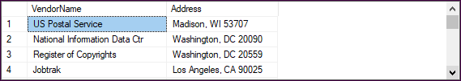
How to format string data using literal values
SELECT VendorName,
VendorCity + ', ' + VendorState + ' ' + VendorZipCode
AS Address
FROM Vendors;

Slide 18
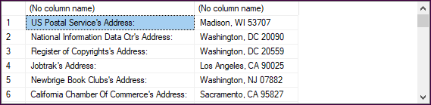
How to include apostrophes in literal values
SELECT VendorName + '''s Address: ',
VendorCity + ', ' + VendorState + ' ' + VendorZipCode
FROM Vendors;

Slide 19
The arithmetic operators in order of precedence
* Multiplication
/ Division
% Modulo (Remainder)
+ Addition
- Subtraction

Slide 20

A statement that calculates the balance due
SELECT InvoiceTotal, PaymentTotal, CreditTotal,
InvoiceTotal - PaymentTotal - CreditTotal
AS BalanceDue
FROM Invoices;

Slide 21

A statement that uses parentheses to control the order of operations
SELECT InvoiceID,
InvoiceID + 7 * 3 AS OrderOfPrecedence,
(InvoiceID + 7) * 3 AS AddFirst
FROM Invoices
ORDER BY InvoiceID;

Slide 22

A statement that uses the modulo operator
SELECT InvoiceID,
InvoiceID / 10 AS Quotient,
InvoiceID % 10 AS Remainder
FROM Invoices
ORDER BY InvoiceID;

Slide 23

A statement that uses the LEFT function
SELECT VendorContactFName, VendorContactLName,
LEFT(VendorContactFName, 1) +
LEFT(VendorContactLName, 1) AS Initials
FROM Vendors;

Slide 24

A statement that uses the CONVERT function
SELECT 'Invoice: #' + InvoiceNumber
+ ', dated ' + CONVERT(char(8), PaymentDate, 1)
+ ' for $' + CONVERT(varchar(9), PaymentTotal, 1)
FROM Invoices;

Slide 25

A statement that computes the age of an invoice
SELECT InvoiceDate,
GETDATE() AS 'Today''s Date',
DATEDIFF(day, InvoiceDate, GETDATE()) AS Age
FROM Invoices;

Slide 26
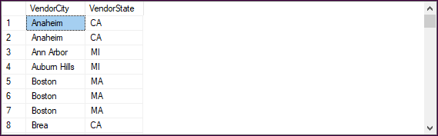
A SELECT statement that returns all rows (122 rows)
SELECT VendorCity, VendorState
FROM Vendors
ORDER BY VendorCity;

Slide 27
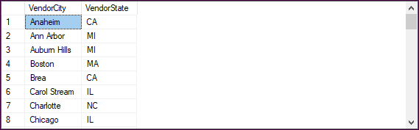
A statement that eliminates duplicate rows (53 rows)
SELECT DISTINCT VendorCity, VendorState
FROM Vendors;

Slide 28
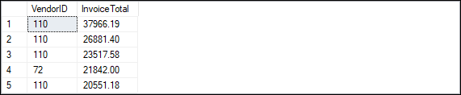
A SELECT statement with a TOP clause
SELECT TOP 5 VendorID, InvoiceTotal
FROM Invoices
ORDER BY InvoiceTotal DESC;

Slide 29
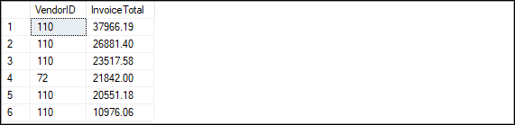
A SELECT statement with the TOP clause and PERCENT keyword
SELECT TOP 5 PERCENT VendorID, InvoiceTotal
FROM Invoices
ORDER BY InvoiceTotal DESC;

Slide 30
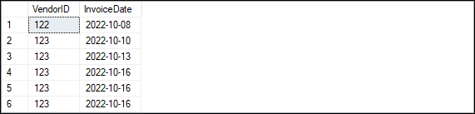
A SELECT statement with a TOP clause and WITH TIES keyword
SELECT TOP 5 WITH TIES VendorID, InvoiceDate
FROM Invoices
ORDER BY InvoiceDate ASC;

Slide 31
Syntax for a WHERE clause with comparison operators
WHERE expression_1 operator expression_2
The comparison operators
= Equal
> Greater than
< Less than
<= Less than or equal to
>= Greater than or equal to
<> Not equal

Slide 32
WHERE clauses that retrieve…
Vendors located in Iowa
WHERE VendorState = 'IA'
Invoices with a balance due
WHERE InvoiceTotal - PaymentTotal - CreditTotal > 0
WHERE InvoiceTotal > PaymentTotal + CreditTotal
Vendors with names from A to L
WHERE VendorName < 'M'
Invoices on or before a specified date
WHERE InvoiceDate <= '2023-01-31'
Invoices on or after a specified date
WHERE InvoiceDate >= '1/1/22'
Invoices with credits that don’t equal zero
WHERE CreditTotal <> 0

Slide 33
Syntax for a WHERE clause with logical operators
WHERE [NOT] search_condition_1 {AND|OR} [NOT] search_condition_2 ...

Slide 34
WHERE clauses that use logical operators
The AND operator
WHERE VendorState = 'NJ' AND YTDPurchases > 200
The OR operator
WHERE VendorState = 'NJ' OR YTDPurchases > 200
The NOT operator
WHERE NOT (InvoiceTotal >= 5000 OR
NOT InvoiceDate <= '2023-02-01')
The same condition without the NOT operator
WHERE InvoiceTotal < 5000 AND InvoiceDate <= '2023-02-01'

Slide 35

A compound condition without parentheses (34 rows)
WHERE InvoiceDate > '01/01/2023'
OR InvoiceTotal > 500
AND InvoiceTotal - PaymentTotal - CreditTotal > 0
Order of precedence for compound conditions
NOT
AND
OR

Slide 36

The same compound condition with parentheses (11 rows)
WHERE (InvoiceDate > '01/01/2023'
OR InvoiceTotal > 500)
AND InvoiceTotal - PaymentTotal - CreditTotal > 0

Slide 37
Syntax of the WHERE clause with an IN phrase
WHERE test_expression [NOT] IN ({subquery|expression_1 [, expression_2]...})

Slide 38
WHERE clauses that use the IN phrase
With a list of numeric literals
WHERE TermsID IN (1, 3, 4)
Preceded by NOT
WHERE VendorState NOT IN ('CA', 'NV', 'OR')
With a subquery
WHERE VendorID IN
(SELECT VendorID
FROM Invoices
WHERE InvoiceDate = '2022-12-01')

Slide 39
The syntax of the WHERE clause with a BETWEEN phrase
WHERE test_expression [NOT] BETWEEN begin_expression
AND end_expression
An equivalent WHERE clause without the BETWEEN phrase
WHERE [NOT] (test_expression >= begin_expression
AND test_expression <= end_expression)

Slide 40
WHERE clauses that use the BETWEEN phrase
With literal values
WHERE InvoiceDate BETWEEN '2023-01-01' AND '2023-01-31'
Preceded by NOT
WHERE VendorZipCode NOT BETWEEN 93600 AND 93799
With a test expression coded as a calculated value
WHERE InvoiceTotal - PaymentTotal - CreditTotal BETWEEN 200 AND 500
With the limits coded as calculated values
WHERE InvoiceDueDate BETWEEN GETDATE() AND GETDATE() + 30

Slide 41
Syntax of the WHERE clause with a LIKE phrase
WHERE match_expression [NOT] LIKE pattern
Wildcard symbols used in patterns
Symbol | Matches…
% | Any string of zero or more characters
_ | Any single character
[ ] | A single character listed within the brackets
[ - ] | A single character within the given range
[ ^ ] | A single character not listed after the caret

Slide 42
WHERE clauses that use the LIKE phrase
WHERE VendorCity LIKE 'SAN%'
// "San Diego" and "Santa Ana"
WHERE VendorName LIKE 'COMPU_ER%'
// "Compuserve" and "Computerworld"
WHERE VendorContactLName LIKE 'DAMI[EO]N'
// "Damien" and "Damion"
WHERE VendorState LIKE 'N[A-J]'
// "NC" and "NJ" but not "NV" or "NY"
WHERE VendorState LIKE 'N[^K-Y]'
// "NC" and "NJ" but not "NV" or "NY"
WHERE VendorZipCode NOT LIKE '[1-9]%'
// "02107" and "08816"

Slide 43
The syntax of the WHERE clause with the IS NULL clause
WHERE expression IS [NOT] NULL

Slide 44
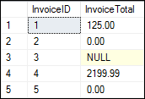
The NullSample table
SELECT *
FROM NullSample;

Slide 45


Retrieve rows with zero and non-zero values
Zero values
SELECT *
FROM NullSample
WHERE InvoiceTotal = 0;
Non-zero values
SELECT *
FROM NullSample
WHERE InvoiceTotal <> 0;

Slide 46


Retrieve rows with and without null values
With null values
SELECT *
FROM NullSample
WHERE InvoiceTotal IS NULL;
Without null values
SELECT *
FROM NullSample
WHERE InvoiceTotal IS NOT NULL;

Slide 47
The expanded syntax of the ORDER BY clause
ORDER BY expression [ASC|DESC]
[, expression [ASC|DESC]] ...

Slide 48

An ORDER BY clause that sorts by one column
SELECT VendorName,
VendorCity + ', ' + VendorState + ' ' + VendorZipCode AS Address
FROM Vendors
ORDER BY VendorName;

Slide 49
The default sequence for an ascending sort
Nulls
Special characters
Numbers
Letters

Slide 50

An ORDER BY clause that sorts by one column in descending sequence
SELECT VendorName,
VendorCity + ', ' + VendorState + ' ' + VendorZipCode
AS Address
FROM Vendors
ORDER BY VendorName DESC;

Slide 51
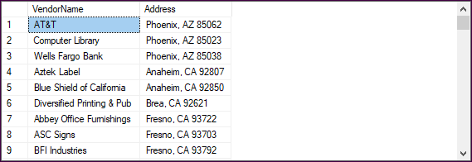
An ORDER BY clause that sorts by three columns
SELECT VendorName,
VendorCity + ', ' + VendorState + ' ' + VendorZipCode
AS Address
FROM Vendors
ORDER BY VendorState, VendorCity, VendorName;

Slide 52

An ORDER BY clause that uses an alias
SELECT VendorName,
VendorCity + ', ' + VendorState + ' ' + VendorZipCode
AS Address
FROM Vendors
ORDER BY Address, VendorName;

Slide 53

An ORDER BY clause that uses an expression
SELECT VendorName,
VendorCity + ', ' + VendorState + ' ' + VendorZipCode
AS Address
FROM Vendors
ORDER BY VendorContactLName + VendorContactFName;

Slide 54

An ORDER BY clause that uses column positions
SELECT VendorName,
VendorCity + ', ' + VendorState + ' ' + VendorZipCode
AS Address
FROM Vendors
ORDER BY 2, 1;

Slide 55
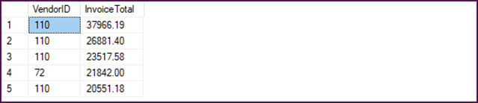
The syntax of the ORDER BY clause for retrieving a range of rows
ORDER BY order_by_list
OFFSET offset_row_count {ROW|ROWS}
[FETCH {FIRST|NEXT} fetch_row_count {ROW|ROWS} ONLY]
An ORDER BY clause that retrieves the first five rows
SELECT VendorID, InvoiceTotal
FROM Invoices
ORDER BY InvoiceTotal DESC
OFFSET 0 ROWS
FETCH FIRST 5 ROWS ONLY;

Slide 56
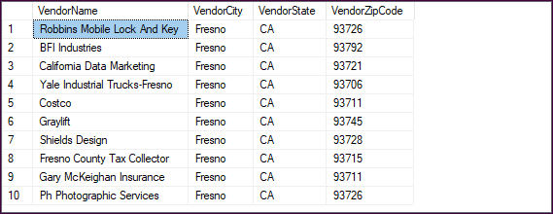
An ORDER BY clause that retrieves rows 11 through 20
SELECT VendorName, VendorCity, VendorState, VendorZipCode
FROM Vendors
WHERE VendorState = 'CA'
ORDER BY VendorCity
OFFSET 10 ROWS
FETCH NEXT 10 ROWS ONLY;

